Slide 1
A particle with positive charge q and mass m moves with speed v in a circle with radius R.
v
R
q, m
Notes:
Setup for the next few calculations

Slide 2
A particle with positive charge q and mass m moves with speed v in a circle with radius R.
What is the particle’s
angular momentum?
v
R
q, m
Notes:
L = r x p
= mvr

Slide 3
A particle with positive charge q and mass m moves with speed v in a circle with radius R.
What is the particle’s
magnetic moment?
v
R
q,m
Notes:
mu = IA
= (q/T) (pi R^2)
= q pi R^2/ (2pi R/v)
= q R v/2

Slide 4
A particle with positive charge q and mass m moves with speed v in a circle with radius R.
What is the particle’s
magnetic moment in terms of its
angular momentum?
v
R
q,m
Notes:
mu = qRv/2
= (q/2m) L

Slide 5
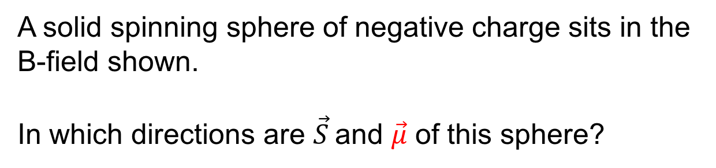
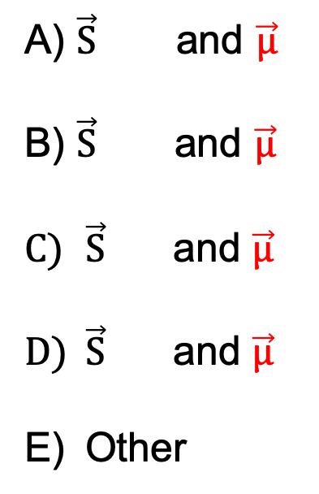
A solid spinning sphere of negative charge sits in the
B-field shown.
In which directions are $\vec{S}$and $\vec{μ}$ of this sphere?
A) $\vec{S}$and $\vec{μ}$
B) $\vec{S}$ and $\vec{μ}$
$\vec{S}$ and $\vec{μ}$
$\vec{S}$ and $\vec{μ}$
Other
- - - -
Notes:
CORRECT ANSWER: D
USED IN: Fa2016 (SJP)
LECTURE NUMBER: 1
STUDENT RESPONSES: 6,0,23,[[71]], 0
INSTRUCTOR NOTES:
WRITTEN BY: Gina Passante (CSF), adapted by SJP
SJP Comments: The direction of spin is slightly hard to see in my picture, but I VERY clearly explained it in front of them to make sure there was no ambiguity.
Some have forgotten their “right hand rule”/
A few voted A (meaning they got spin right, but missed the negative sign in mu?)
¼ voted for C, exactly reversed, but I did not get the reasons from them. But they, at least are seeing the “sign” issue

Slide 6
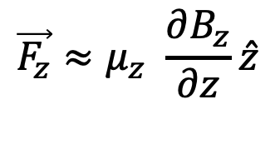


In which direction is the approximate force on the sphere?
$$\vec{F_{z}}≈μ_{z} \frac{∂B_{z}}{∂z}\hat{z}$$
A) Up
Down
Zero
z
$$\vec{μ}$$
- - - -
$$\vec{S}$$
Notes:
CORRECT ANSWER: B
USED IN: Fa2016 (SJP)
LECTURE NUMBER: 1
STUDENT RESPONSES: 53, [[43]], 3, 0, 0
INSTRUCTOR NOTES: muz is +, but dBz/dz in the figure is negative, so force is down (and spin is down) That’s why the SG is “S on top”, so that spin up goes up…
WRITTEN BY: Gina Passante (CSF), adapted by SJP
SJP Comments: This was about 90% WRONG at first, so I pointed out to them that they need to look carefully at the figure and decide what the sign of dBz/dz is… This helped, and it quickly shifted to closer to 50/50. It was quite rushed (had <1 minute!)

Slide 7
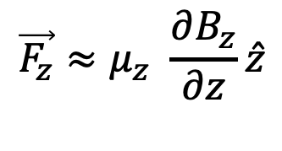
The two spheres are spinning with the same angular momentum, just oriented differently.
Which sphere feels the larger |force?|
$$\vec{F_{z}}≈μ_{z} \frac{∂B_{z}}{∂z}\hat{z}$$
A) A
B
It’s the same.
A
- - - -
- - - -
B
S
S
Notes:
CORRECT ANSWER: A
USED IN: Fa2016 (SJP)
LECTURE NUMBER: 1
STUDENT RESPONSES: 0% [[0%]] 0% 0% 0%
INSTRUCTOR NOTES: |Force| depends on the magnitude of the z component of mu, which is larger for system A.
WRITTEN BY: Gina Passante (CSF), adapted by SJP
SJP Comments:

Slide 8
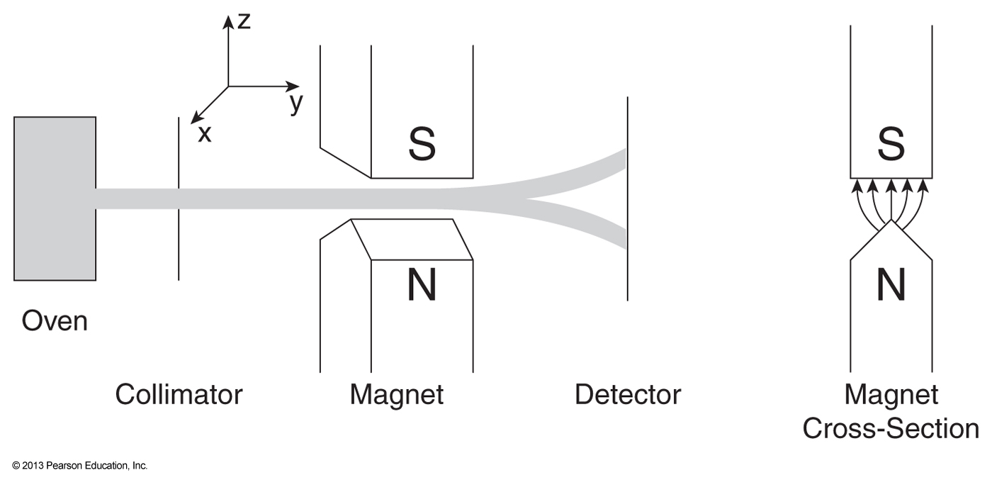
Stern-Gerlach Experiment 1922
Otto Stern won the Nobel Prize in 1943.

Slide 9

$$F_{z}≈g\frac{−e}{2m_{e}} S_{z}\frac{∂B_{z}}{∂z}$$
Given the classical formula
What pattern would you expect to see on the detector screen for neutral spheres with a non-zero magnetic moment oriented randomly?
a.
b.
c.
d.
I don’t know
Notes:
Lecture #1, Phys 3220 Sp16 Responses:
STUDENT RESPONSES:
CORRECT ANSWER: B if we use what we’ve learned so far classically, C is where we’re heading with spin!
FIRST USED IN: Fall 2008 (DeWolfe/Pollock) LECTURE NUMBER: 39
INSTRUCTOR NOTES:
SJP’s Answer: C Lz is quantized in integers, so 2l+1 should be odd. But with spin, we can get any (integer) # of spots. The spacing would be even according to the formula (depending only on the z-component of L)
Classically, it should be a continuous smear.
WRITTEN BY: Steve Pollock
9

Slide 10
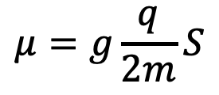
Silver atoms:
Electrically neutral
47 e-,
orbiting nucleus with 47 protons and 60 (or 62) neutrons
protons and neutrons are 2000x more massive,
so insignificant contribution to μ
$$μ=g\frac{q}{2m}S$$
Electronic configuration is:
1s² 2s² 2p⁶ 3s² 3p⁶ 4s² 3d¹⁰ 4p⁶ 4d¹⁰ 5s¹
No overall L or S!
One lone electron
outside closed shells
L=0, but
Does have S

Slide 11
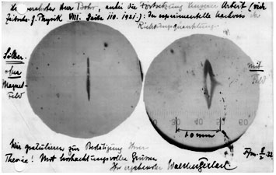
Experimental Result
Postcard sent from Walther Gerlach to Niels Bohr on February 8 1922 shows a photograph of the beam splitting. The message reads: "“....the experimental proof of directional quantisation. We congratulate you on the confirmation of your theory....”

